Slide 1
Maps
By
Lucas Hasting
Ethan Nix
Krutivas Pradhan
Notes:
Krutivas

Slide 2
What is a MAP’s Purpose
The map is an associative container that stores key-value pairs in sorted manner based on the key
A map is used similarly to a dictionary in python
It maps a specific value to another which you specify in a template
It does not matter the typing of either value as long as you remain consistent
It’s purpose is to have one value “map” to another
It allows efficient search, insertion, and deletion operations in logarithmic time complexity
Notes:
Krutivas - Looks good!

Slide 3
Basic functions associated with Map
Begin - Return an iterator to the first element in the map
End - Returns an iterator to the theoretical element that follows the last element in the map
Size - Returns the number of elements in the map
Insert - Adds new element to the map
Remove - Removes the key value from the map
Notes:
Krutivas
See geek for geeks, think of the bigger operations like insert and erase

Slide 4
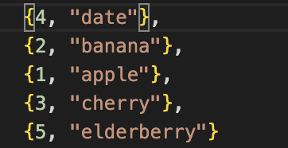
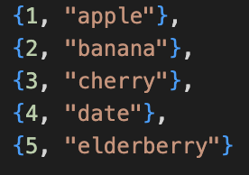
Basic functions associated with Map

Slide 5
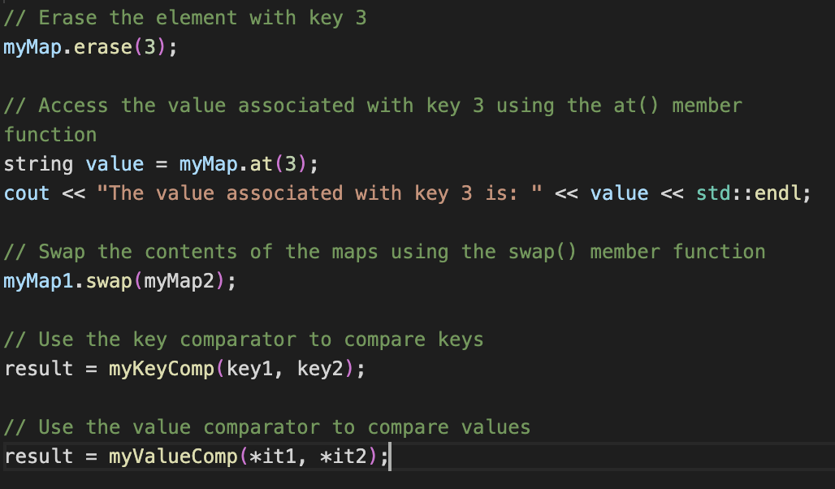
MAPS Demo (Code)
Notes:
Finish Demo File, Upload Screenshots

Slide 6
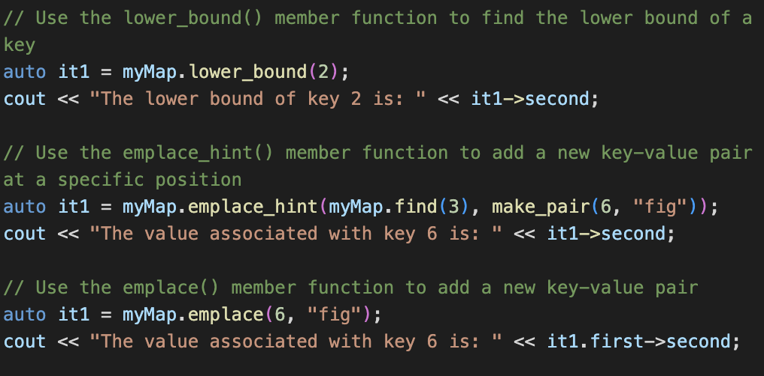
MAPS Demo (Code)

Slide 7
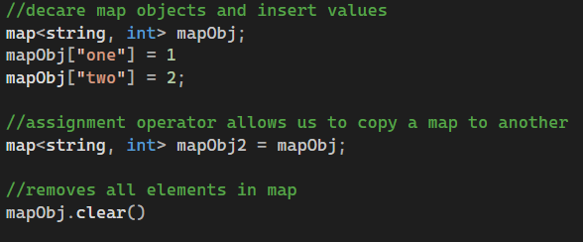
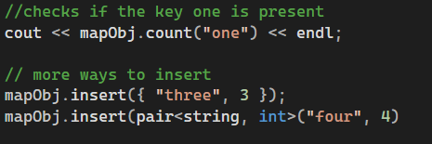
MAPS Demo (Code)
Notes:
Finish Demo File, Upload Screenshots

Slide 8

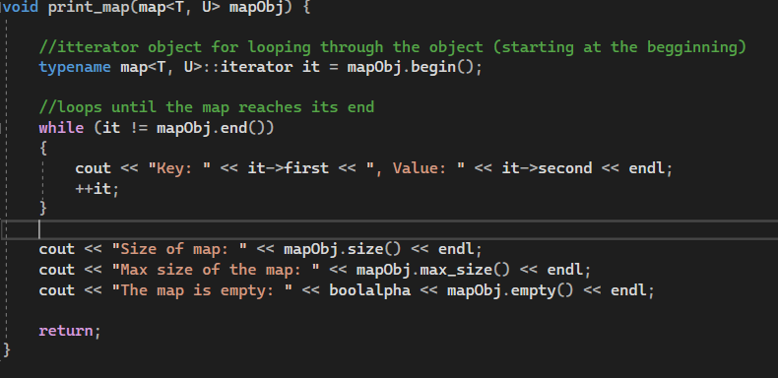
MAPS Demo (Code)
Notes:
Finish Demo File, Upload Screenshots

Slide 9
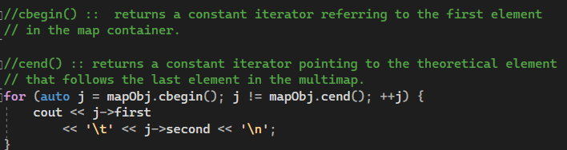
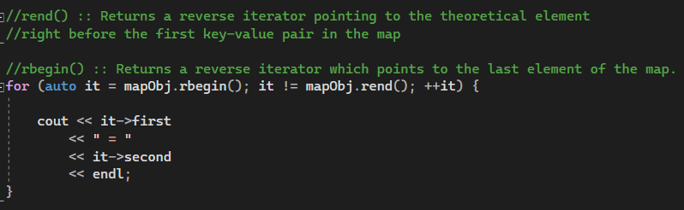
MAPS Demo (Code)

Slide 10
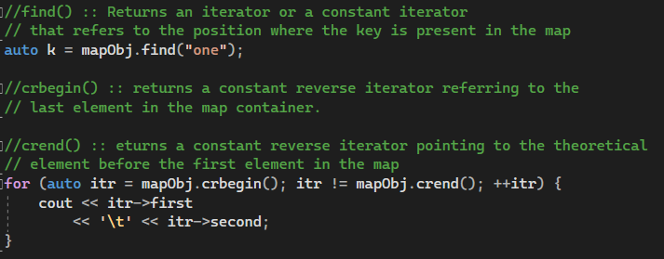
MAPS Demo (Code)

Slide 11
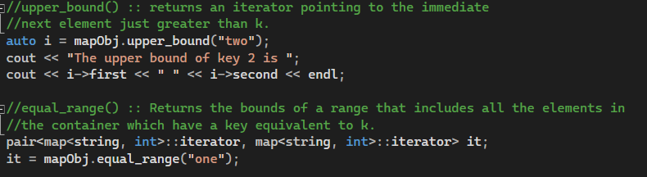
MAPS Demo (Code)

Slide 12
Real World Applications (Problem)
We are trying to solve the problem of creating and deleting user accounts with an application.
The program simulates an application that asks a user to create an account, or sign-in with the account.
From there we can remove an account or change either the username or password.
Once the application closes it saves the accounts and encrypts the password.
Once it opens back up it loads all the accounts.
Notes:
Lucas

Slide 13
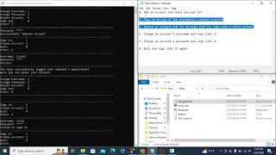
Real World Applications (Demonstration)
Notes:
Done

Slide 14
Conclusion
Maps store elements using a key value and mapped value. The key value is used to give each mapped value a unique identity.
There are many different applications for maps, in our project we decided to create an account management system.
Maps are generally best used in applications where a user needs to find information through an identifier.
Notes:
Ethan

Slide 15
Conclusion
Cons
Large datasets become time consuming to traverse
Better to use a vector for smaller datasets
Unordered Maps can provide a faster search time, if the hash function is sufficient
Pros
Search time of O(logn)
Does not take up as much space as a vector or array.
Can pass multiple arguments to it
(ex. mapObj[“one”] = 1)
Stored in order set by the key values
Notes:
Krutivas / Ethan
Can be more than one slide, don’t look at every container, just a few

Slide 16
References
https://www.vbforums.com/showthread.php?168659-Password-Mask-with-cin
https://stackoverflow.com/questions/3745861/how-to-remove-last-character-put-to-stdcout
https://stackoverflow.com/questions/2310939/remove-last-character-from-c-string
https://www.geeksforgeeks.org/map-associative-containers-the-c-standard-template-library-stl/
https://brilliant.org/wiki/caesar-cipher/#:~:text=A%20Caesar%20cipher%20is%20a,an%20A%2C%20and%20so%20on.
https://softwareengineering.stackexchange.com/questions/117513/what-is-the-advantage-of-using-map-datastructure

Slide 17


